Slide 1
Organizational Structures and personal management
Session 1

Slide 2

Definition of organization
An organization is a group of people who work together. Organizations exist because people working together can achieve more than a person working alone.

Slide 3

Definition of management
Management means directing and controlling a group of people or an organization to reach a goal. Management often means the deployment and manipulation of human resources, financial resources, technological resources and Material resources
Notes:
Deployment-the action of bringing resources into effective action
Manipulating-handle or control (a tool, mechanism, information, etc.) in a skilful manner

Slide 4
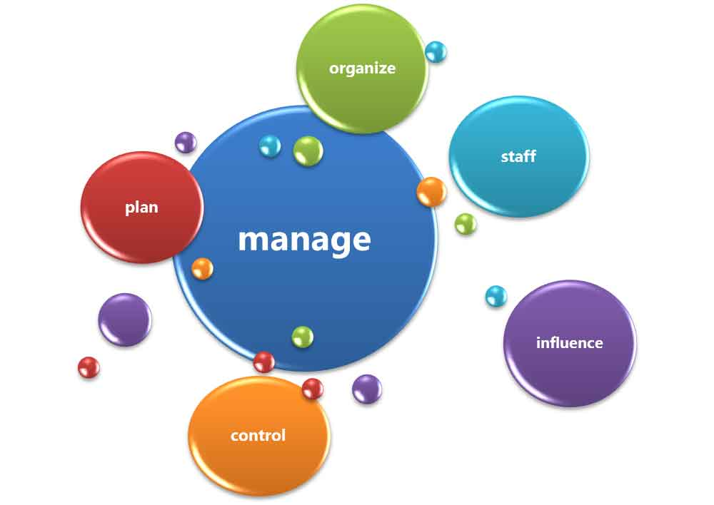
The functions of management
Planning
Organizing
Staffing
Leading
Controlling

Slide 5
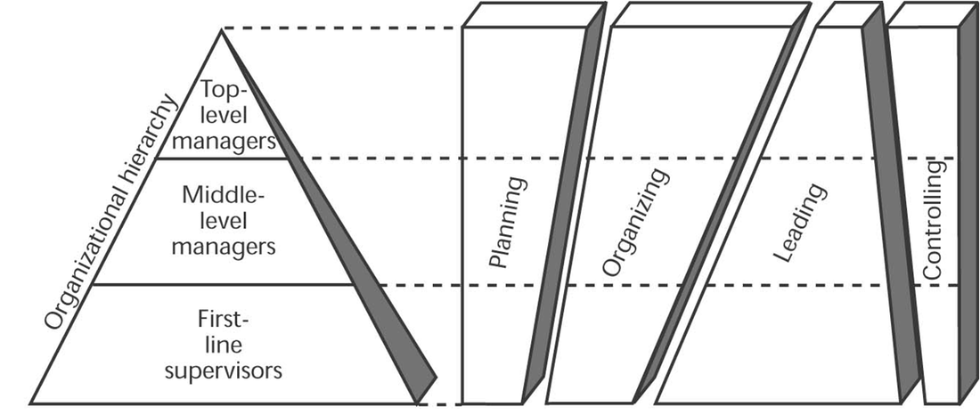
Managerial functions at different organizational levels

Slide 6
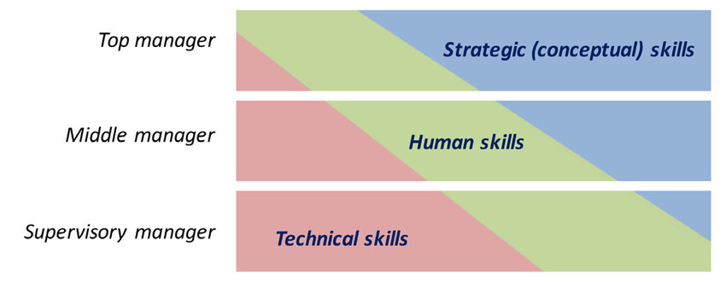
Managerial skills and the organizational hierarchy
Notes:
Conceptual skills are abilities that allow an individual to understand complex situations to develop creative and successful solutions.

Slide 7
The goals of all managers and organizations
To create a surplus, by establishing an environment in which people can accomplish group goals with least amount of time, money, materials and personal dissatisfaction.

Slide 8



Technology-globalization-entrepreneurship
To be successful in the 21st century, companies must take advantage of the new information technology, globalization and entrepreneurship

Slide 9
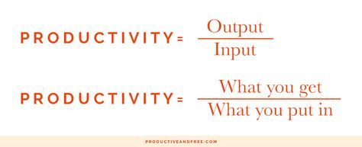
productivity
Productivity can be improved by
1)Increasing outputs with the same inputs
2)Decreasing inputs but maintaining the same outputs, or
3)Increasing outputs and decreasing inputs to change the ratio favorably

Slide 10
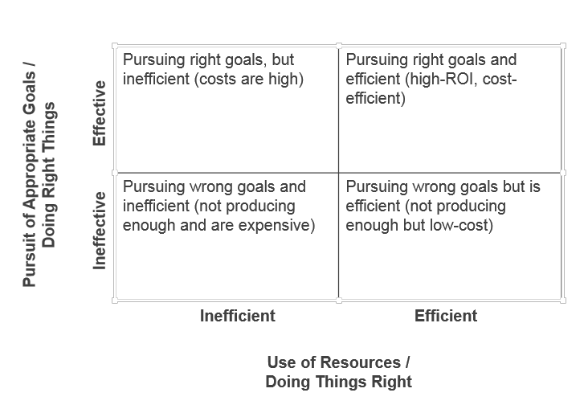
Effectiveness and efficiency

Slide 11
Managing science or an art?
Managing as a practice is an art; the organized knowledge underlying the practice may be referred to as a science.
A manager to be successful in his profession must acquire the knowledge of science and the art of applying it.

Slide 12
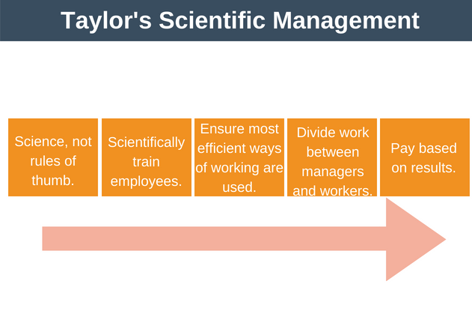
The evolution of Management thought
Frederick Taylor’s scientific management(Father of Scientific Management)

Slide 13
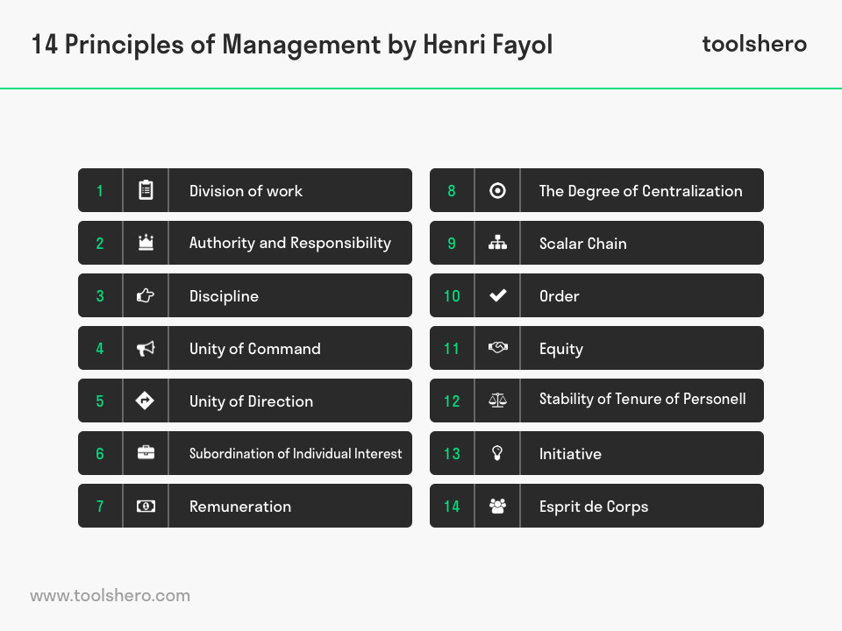
Henri Fayol’s Principle’s of Management

Slide 14
Elton Mayo and F.J.Roethlisberger and the Hawthorne studies(At Hawthorne plant of Western Electric Company)
1. Illumination Experiments(1924-27)(Amount of light at the work place-physical factor)

Slide 15
2. Relay Assembly Test Room Experiments(1927-28)(Productivity increased-division of work to smaller groups, two five-minute rests to ten minutes, Productivity decreased-five minutes rest but frequency increased, Productivity Increased-two ten minutes break with food provided, cutting work hours to an hour). They were made to work back to normal. Absenteeism decreased, morale increased and less supervision

Slide 16
3. Mass Interviewing Programme(1928-30)

Slide 17
4. Bank Wiring Observation Room Experiment(1931-32)

Slide 18
It was concluded that social relationship among workers, participation in decision-making, etc. had a greater effect on productivity than working conditions.

